Slide 1
Filastiniyat a pro-active media advocacy organization committed to ensuring and supporting the equitable participation of Palestinian women and youth at all levels of public spheres and all forums of public discourse.

Slide 2
TV Talk-show from Gaza

Slide 3
Palestinian Female Journalists’ Club
Gaza
Jericho

Slide 4
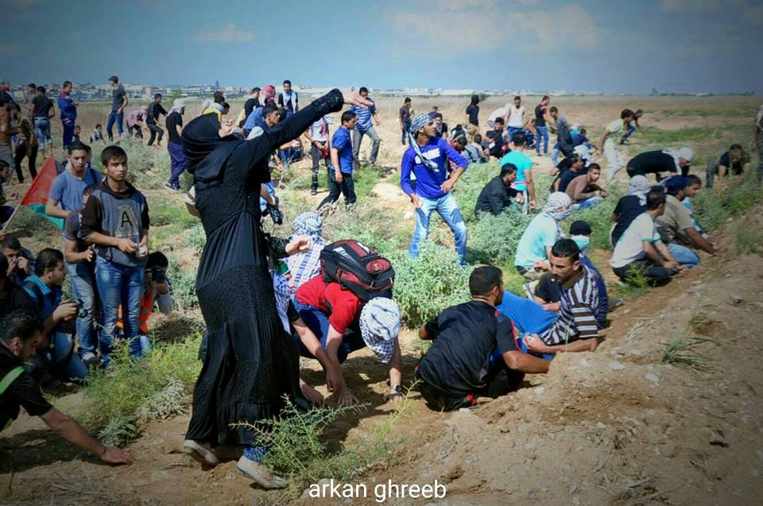
NAWA: Women News Network

Slide 5
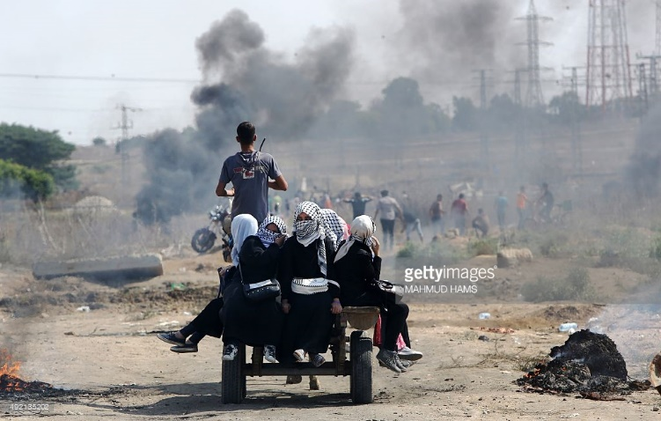
NAWA: Women News Network

Slide 6
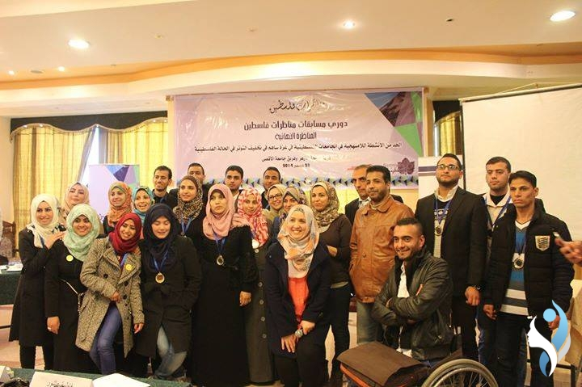
Debate Club: Youth for Social Change
Gaza
Ramallah

Slide 7
Model
Talk-show: 1 million, 379,000 Views

Slide 8
Women Can Do It

Slide 9
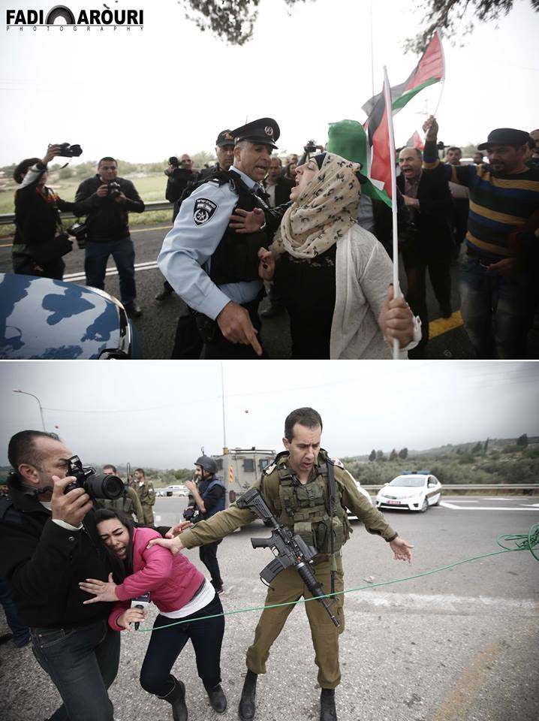
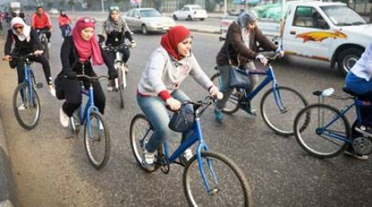
Women Can Do It
Fight and ride

